Slide 1
Some testing stuff
Some annoying animation

Slide 2
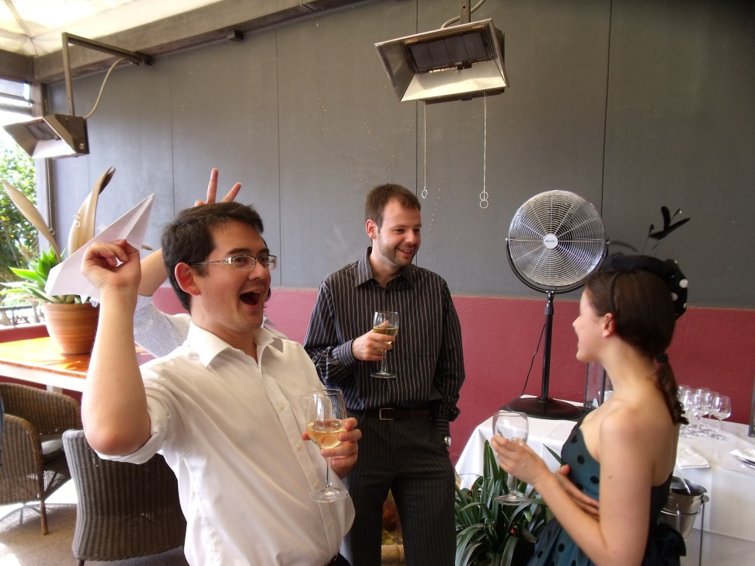
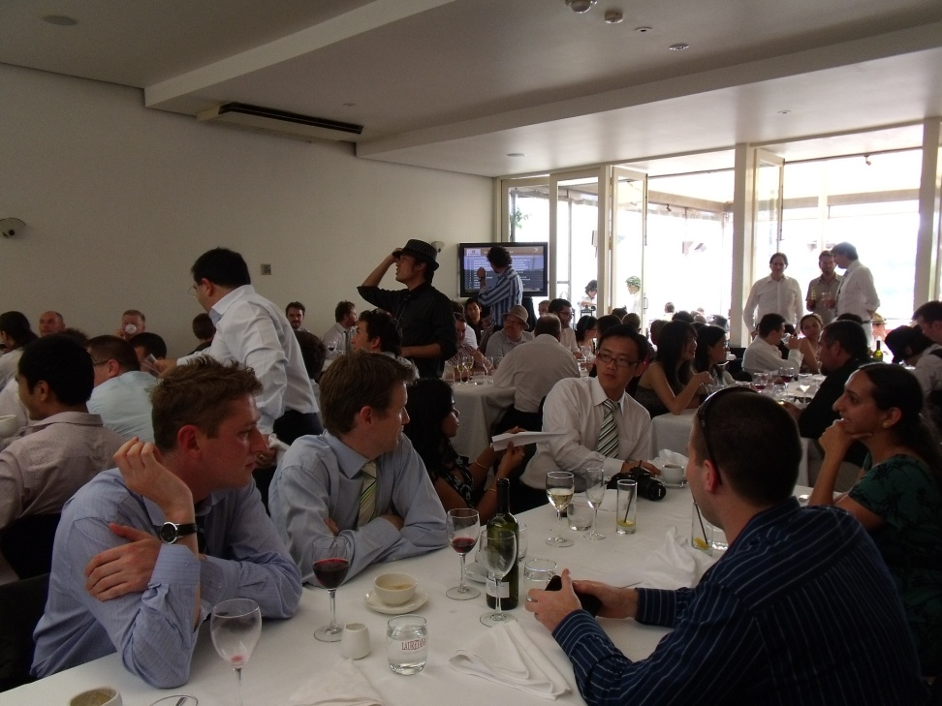
Melbourne Cup

